Slide 1


NUMBER SYSTEM

Slide 2
NUMBER SYSTEM
PRESENTED BY
241-15-391>Mahmudul Islam Himel
241-15-918>Istyaq Ahmed Abdullah
241-15-339>Md Rahat
241-15-112>Md.Jubayer Al Asif
241-15-557>Nahid Al Galib

Slide 3
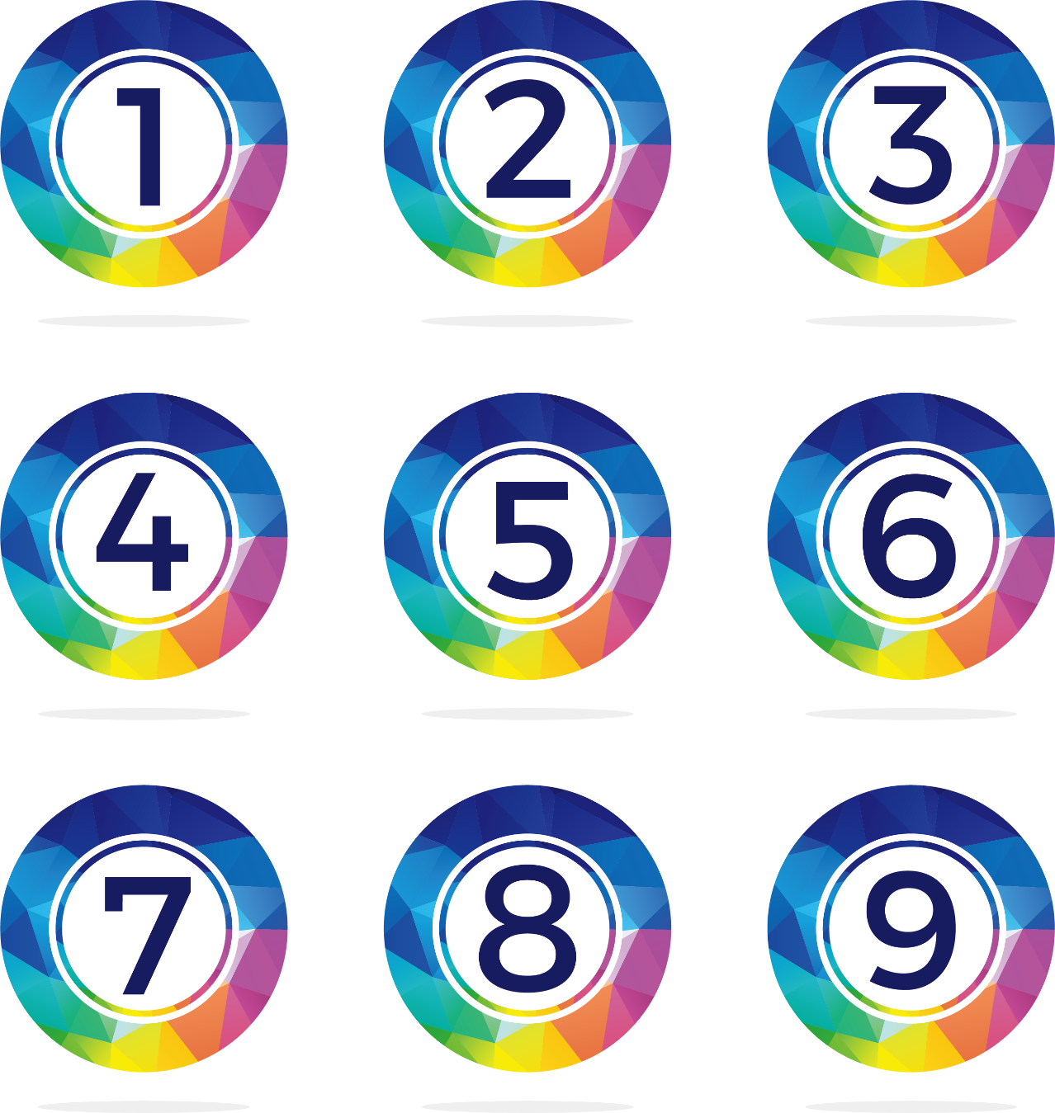
NUMBER SYSTEM
INTRODUCTION
A number system is a mathematical notation for representing numbers, which is essential for counting, measuring, and performing mathematical operations.

Slide 4
NUMBER SYSTEM
REAL LIFE USES
Engineering and Physics
Medicine and Biology
Statistics and Data Analysis
Geography and Navigation

Slide 5
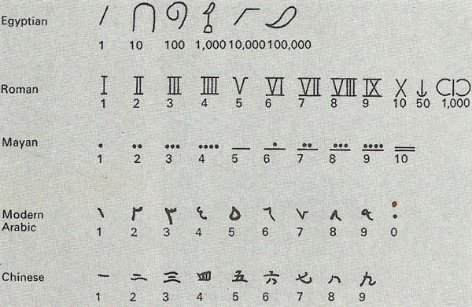
NUMBER SYSTEM
HISTORY
Number systems have progressed from the use of fingers and tally marks, perhaps more than 40,000 years ago.

Slide 6
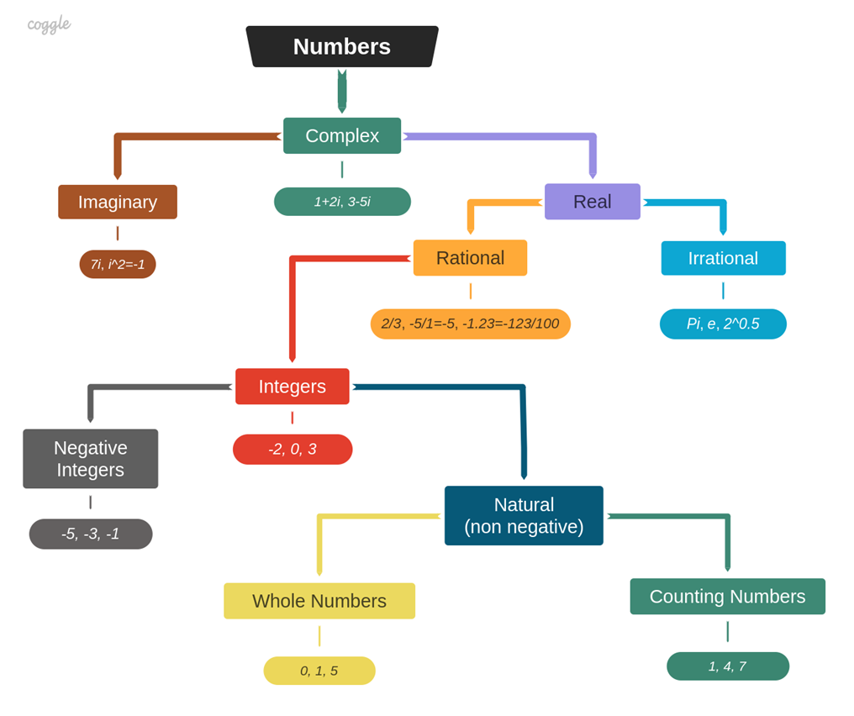
NUMBER SYSTEM
CLASSIFICATION OF NUMBERS

Slide 7
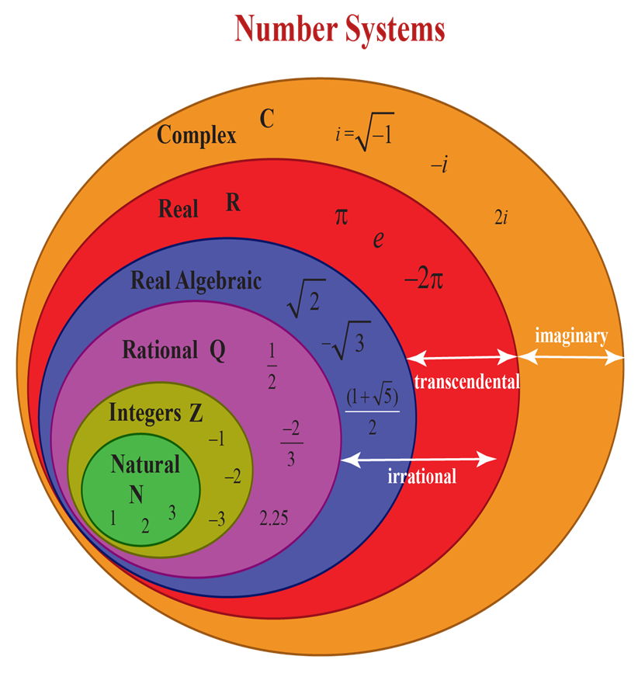
NUMBER SYSTEM
CLASSIFICATION OF NUMBERS

Slide 8
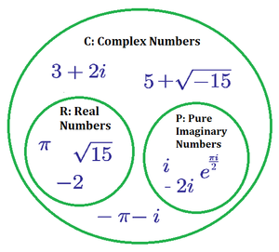
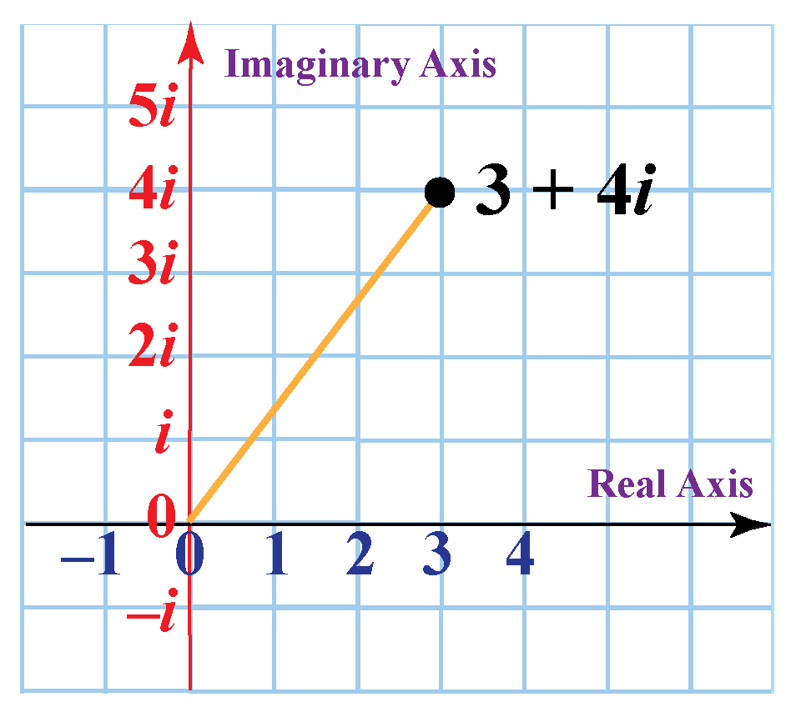
NUMBER SYSTEM
COMPLEX NUMBER
Here i is a imaginary unit

Slide 9
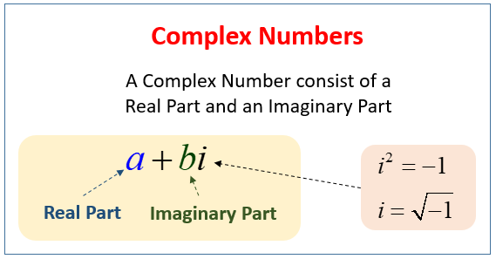
NUMBER SYSTEM
COMPLEX NUMBER
Real Part
Complex Number
Imaginary Part
The main difference between real part and imaginary part is i.
Imaginary always carry a imaginary unit i.

Slide 10
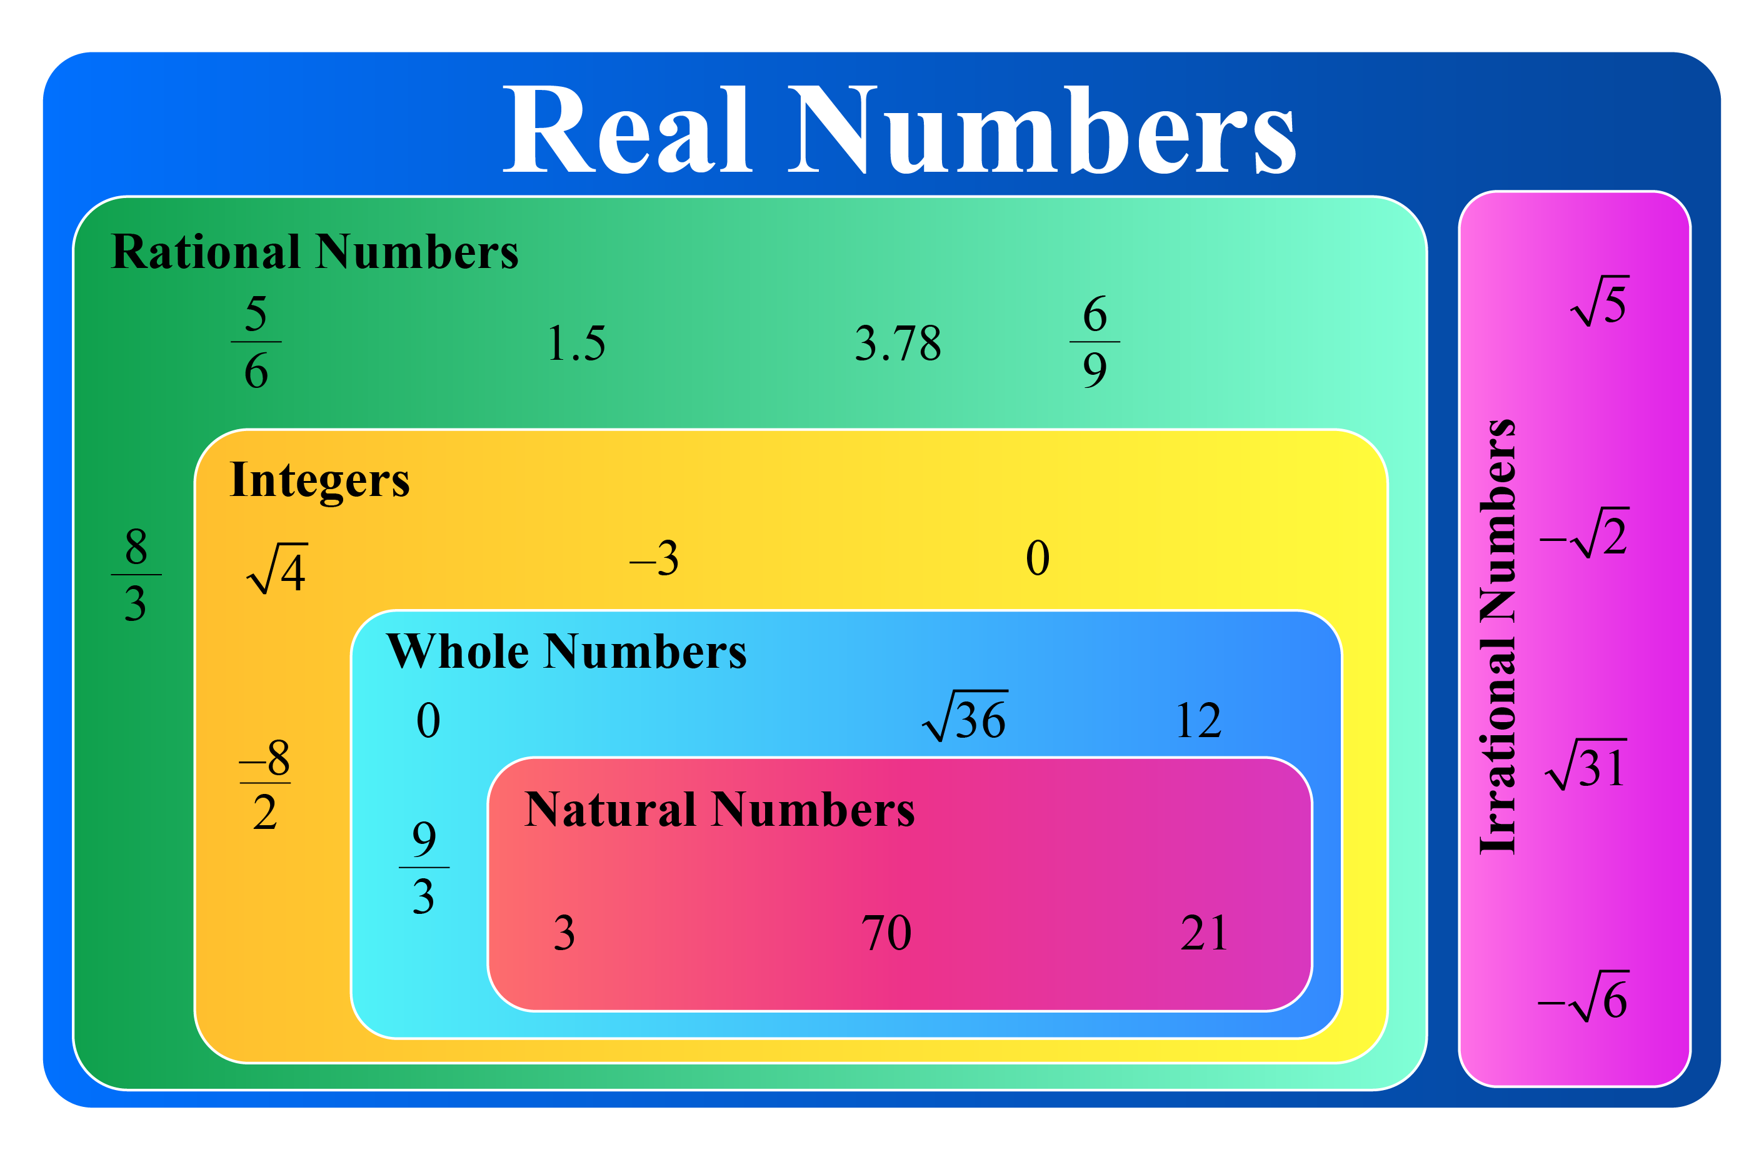
NUMBER SYSTEM
REAL NUMBER

Slide 11
NUMBER SYSTEM
REAL NUMBER
Real Number
Rational
number
Irrational
number
Rational Number IS Any Number That Can Be Written As A Ratio Or Fraction
An Irrational Number Is A Real Number That Cannot Be Written As A Simple Fraction

Slide 12
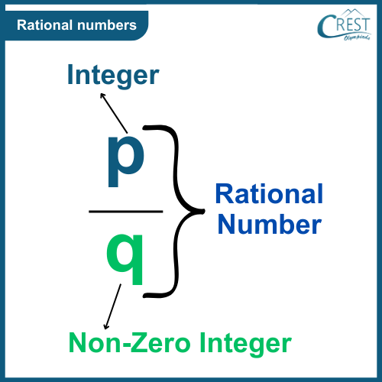
NUMBER SYSTEM
RATIONAL NUMBER
A rational number is any number that can be written as a fraction, where both the numerator and the denominator are integers, and the denominator is not equal to zero.

Slide 13
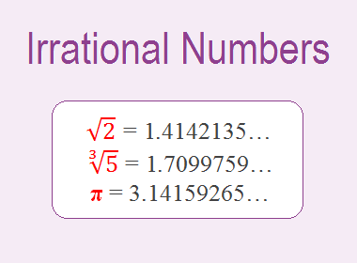
NUMBER SYSTEM
IRRATIONAL NUMBER
Irrational Number Is A Type Of Real An Number Which Cannot Be Represented As A Simple Fraction. It Cannot Be Expressed In The Form Of A Ratio.

Slide 14
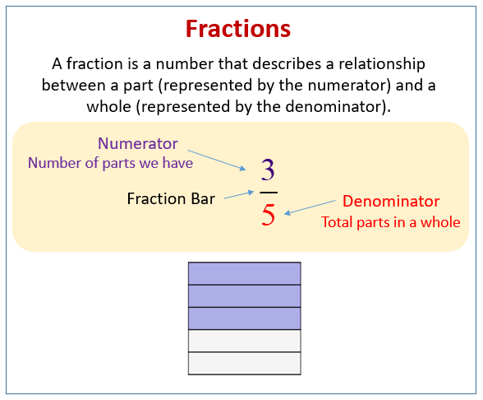
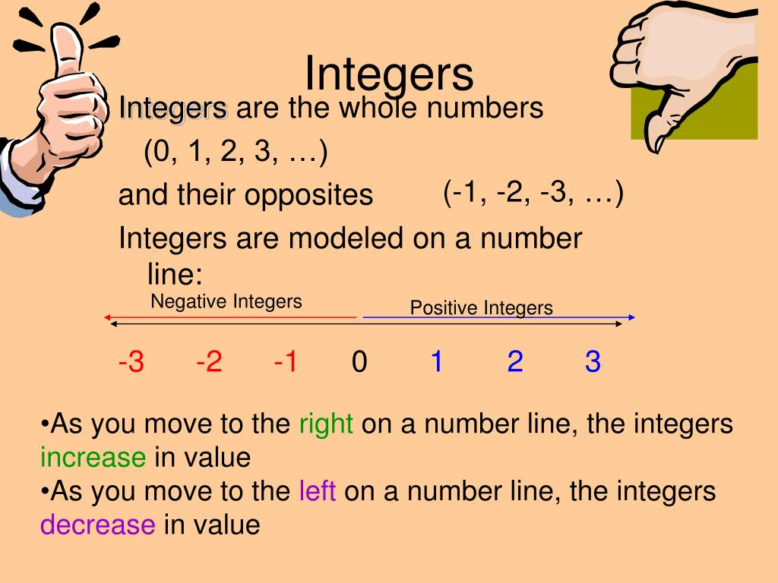
NUMBER SYSTEM
REAL NUMBER
Real Number
Integer
Fraction

Slide 15
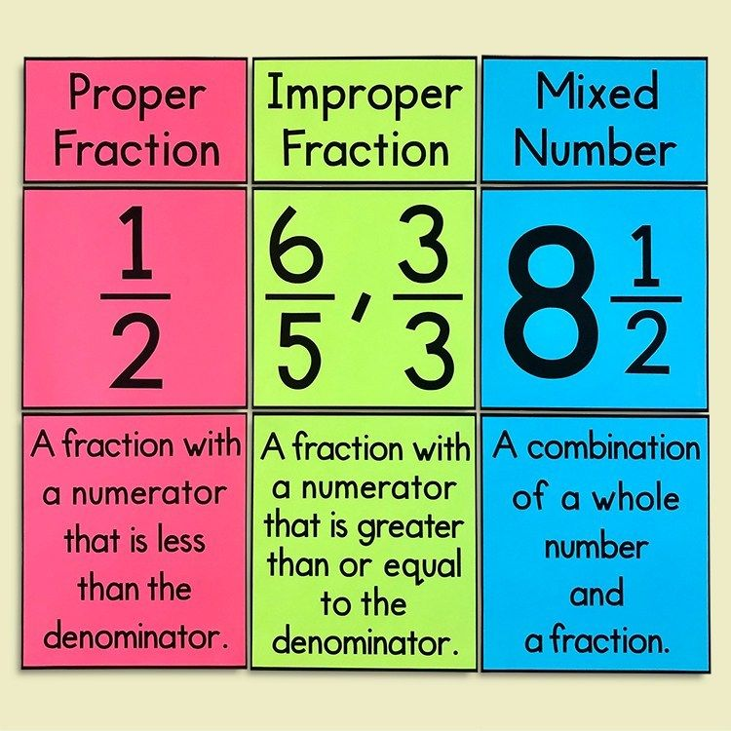
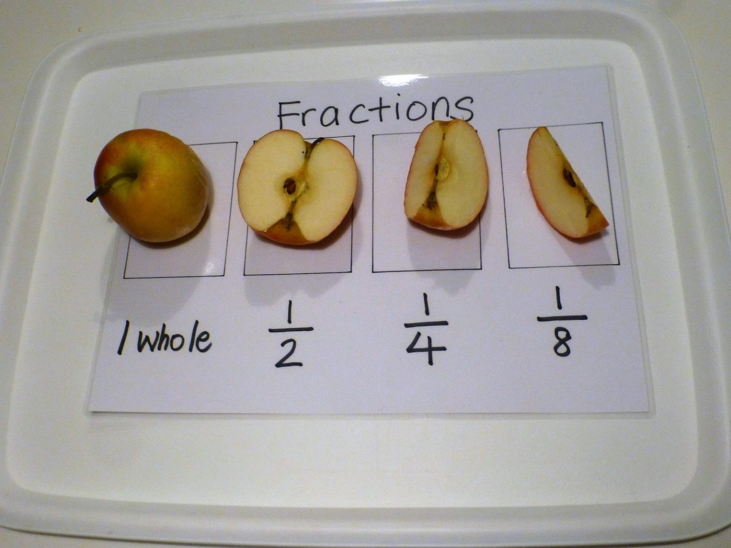
NUMBER SYSTEM
TYPE OF FRACTION

Slide 16
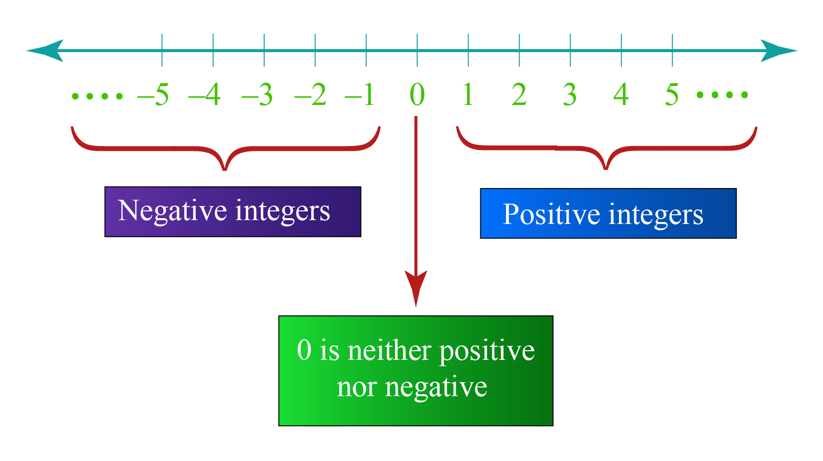
NUMBER SYSTEM
INTEGER

Slide 17

NUMBER SYSTEM
POSITIVE NUMBER
Positive Number
Composite
Prime
Neihter prime nor
Composit
In Mathematics, composite numbers are numbers that have more than two factors.
4 6 8 9 10 15
Those are composite numbers
Prime numbers are numbers greater than 1 that only have two factors, 1 and the number itself.
2 3 7 11 13 17 23
Those are prime numbers

Slide 18
NUMBER SYSTEM
PRIME FACTORIZATION
Prime factorization of a number is the representation of the number by its prime factors.
Example:
36
4
9
2²
3²

Slide 19
NUMBER SYSTEM
PRIME FACTORIZATION
Division Method.
Tree Diagram.
Multiplication.
Formula:
N = Xª × Y^{b} × Z^{c}
Number of factor:
(a+1)(b+1)(c+1)

Slide 20
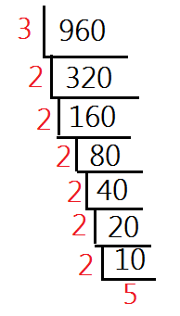
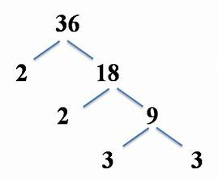
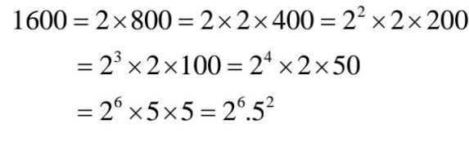
NUMBER SYSTEM
PRIME FACTORIZATION
Division Method.
Tree Diagram.
Multiplication.

Slide 21
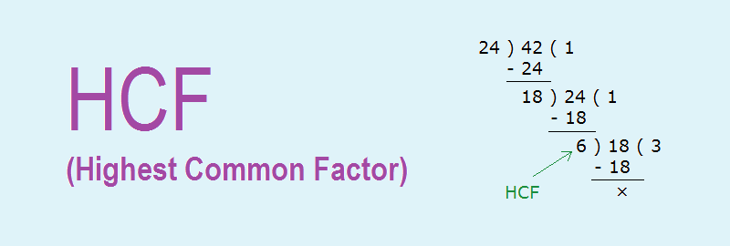
NUMBER SYSTEM
HIGHEST COMMON FACTOR
HCF or Highest Common Factor is the greatest number which divides each of the two or more numbers.
HCF is also called the Greatest Common Measure (GCM) and Greatest Common Divisor(GCD).
Step 1: Write each number as a product of its prime factors. This method is called here prime factorization.
Step 2: Now list the common factors of both the numbers
Step 3: The product of all common prime factors is the HCF ( use the lower power of each common factor)

Slide 22
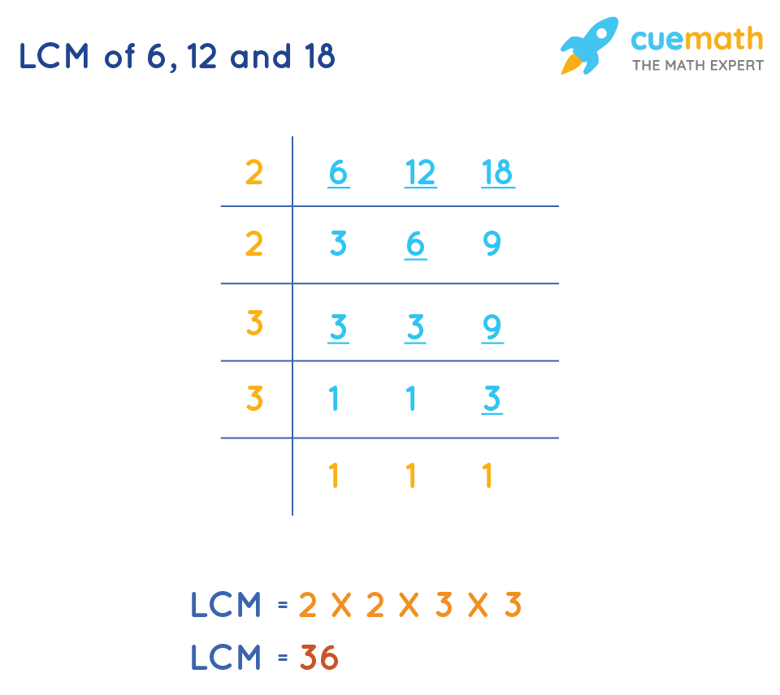
NUMBER SYSTEM
LCM
The LCM of any two is the value that is evenly divisible by the two given numbers.
The full form of LCM is Least Common Multiple.
It is also called the Least Common Divisor (LCD).
Step 1: List the first few multiples of each number.
Step 2: Circle the common multiples.
Step 3: The lowest circled number is the LCM.

Slide 23
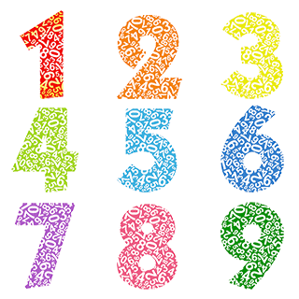
THANK YOU!

